Slide 1

Fast Exact Shortest-Path Distance Queries on Large Networks
Wang Mengge
2016.12.2

Slide 2
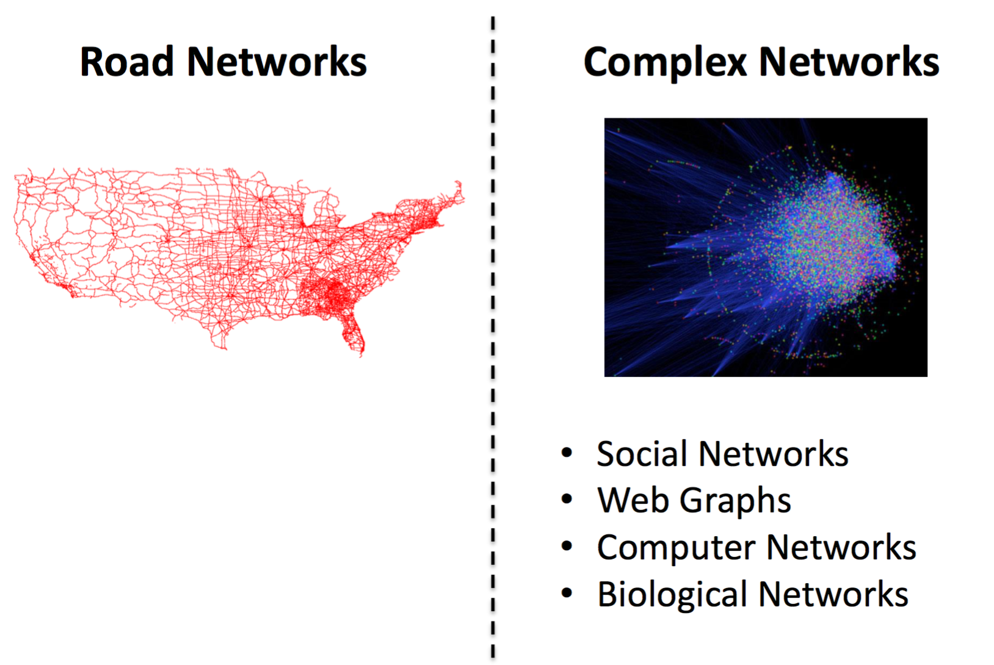
Real-world Networks

Slide 3
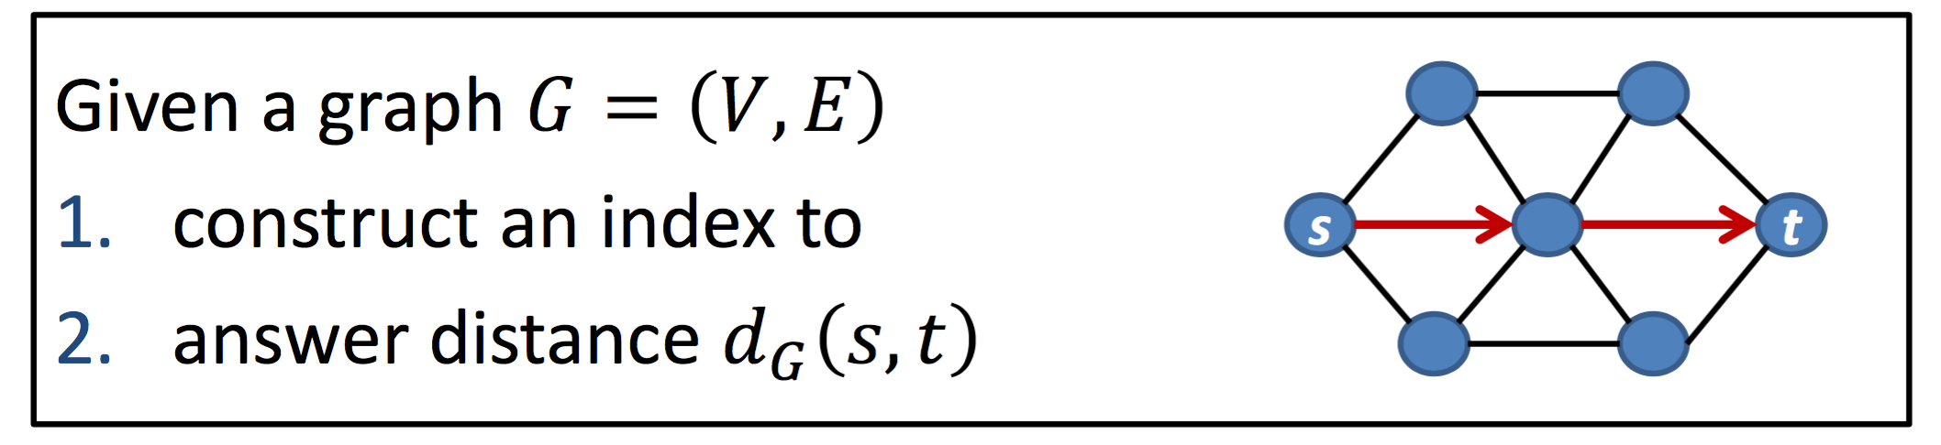

Problem Definition
Goal: Good trade-off
Scalability
Indexing time
Index size
Query Performance
Query time
Precision

Slide 4
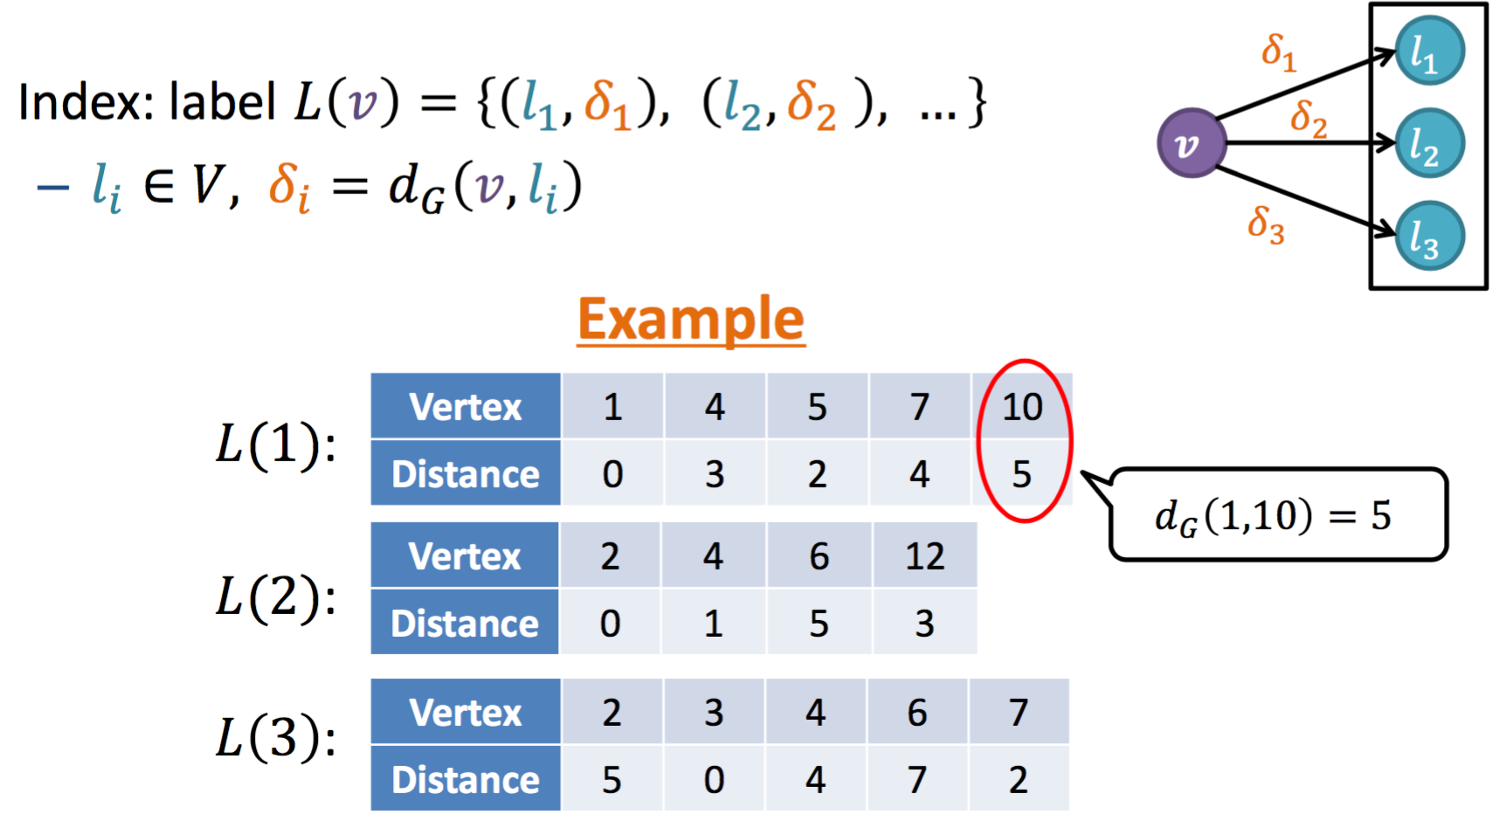
2-Hop Labeling: Index Data Structure
Main idea:
—By selecting some vertices as the center points to cover the connected shortest paths

Slide 5
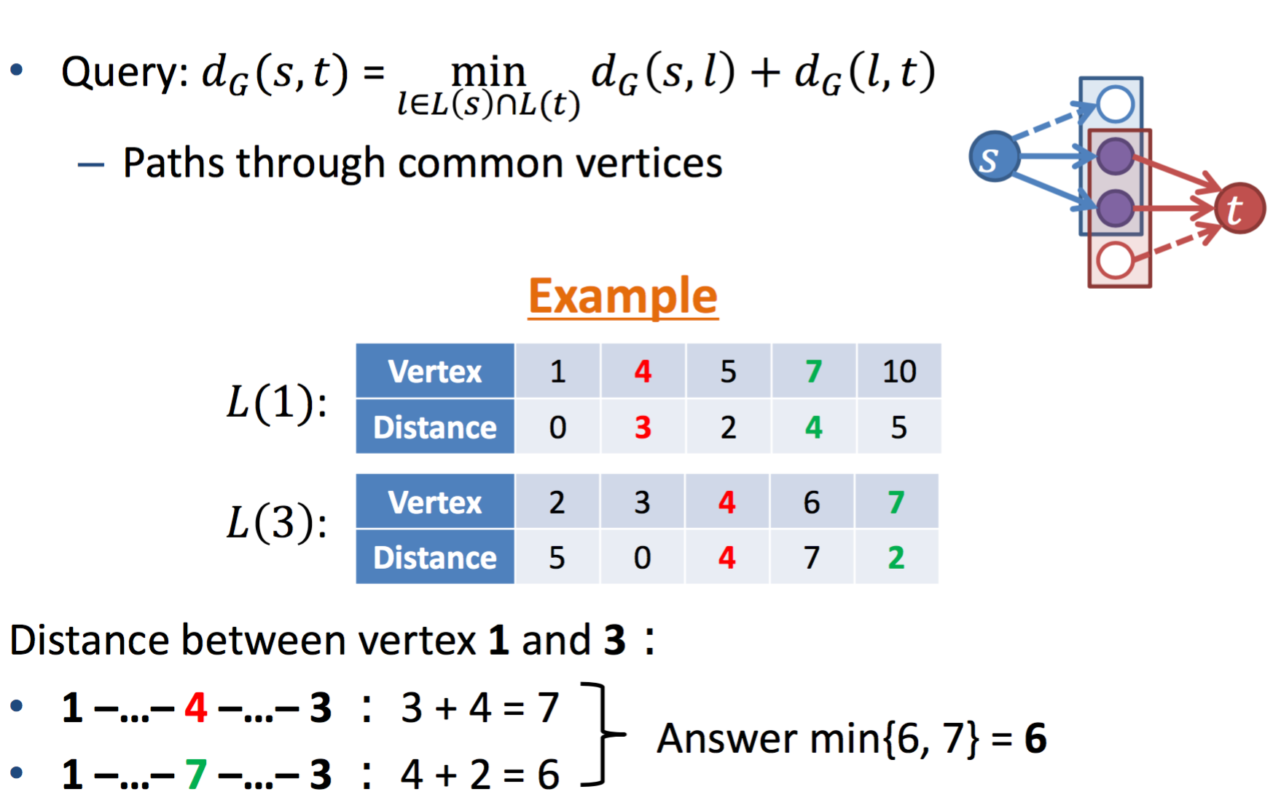
2-Hop Labeling: Query Algorithm

Slide 6
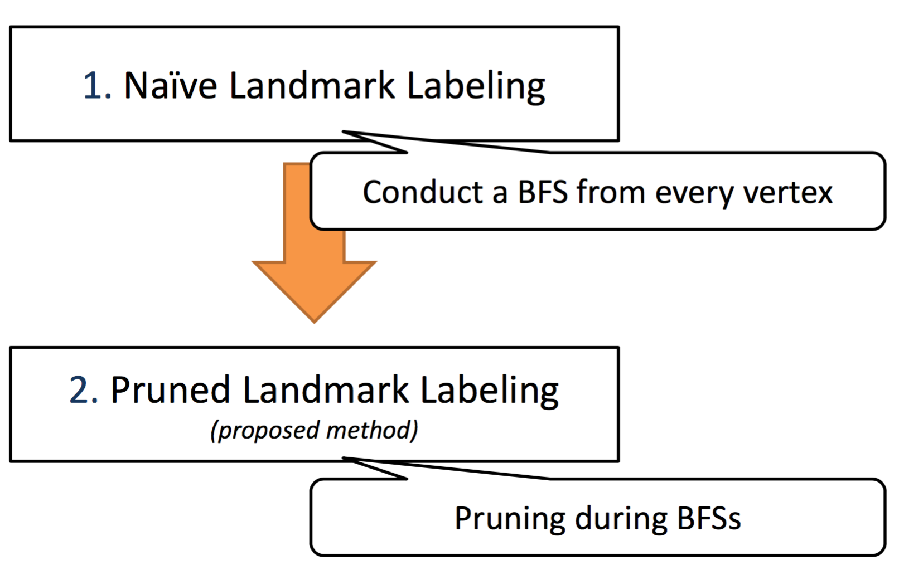
Approach

Slide 7
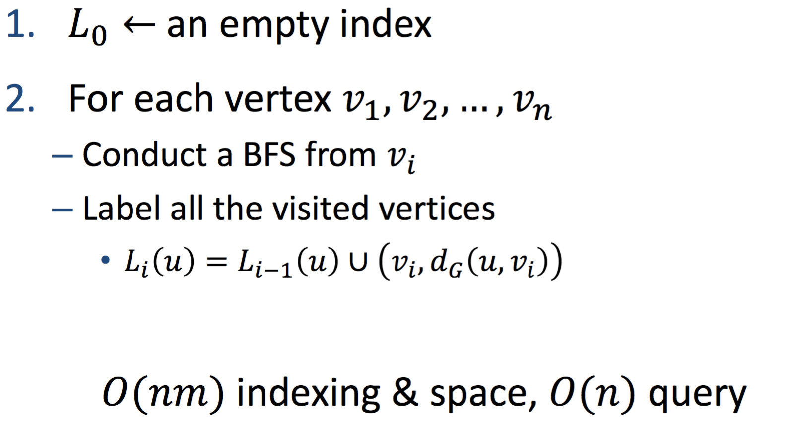
Naive Landmark Labeling

Slide 8
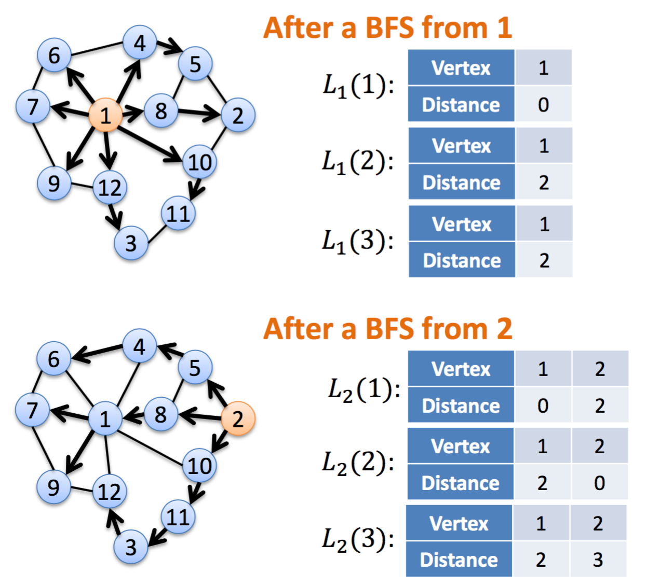
Example

Slide 9
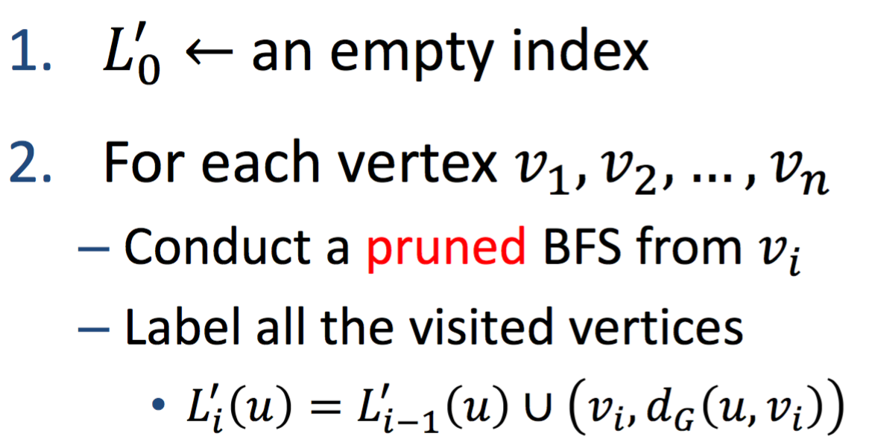
Pruned Landmark Labeling

Slide 10
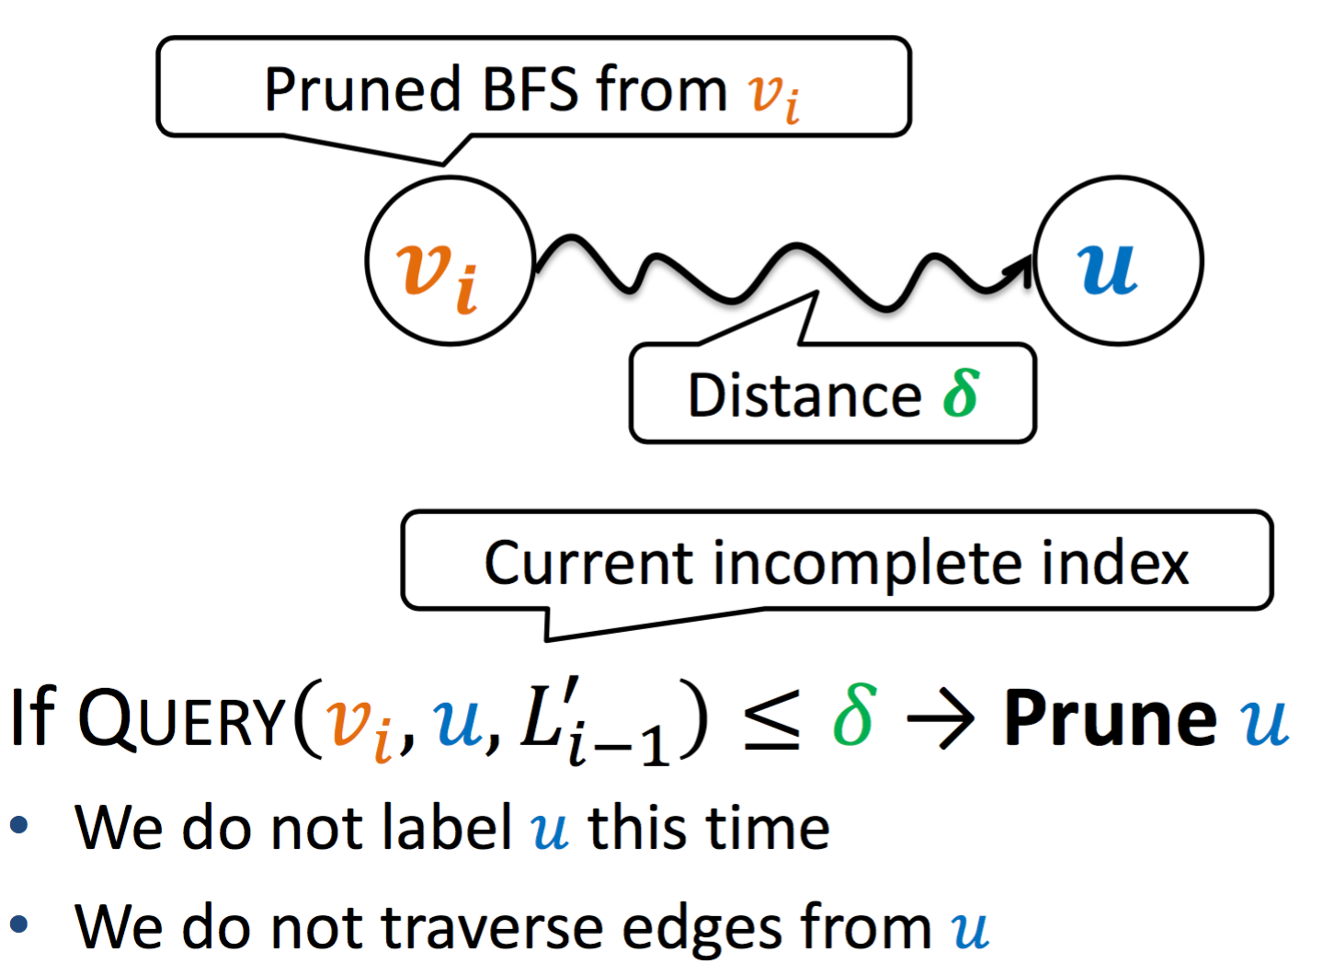
Pruned BFSs

Slide 11
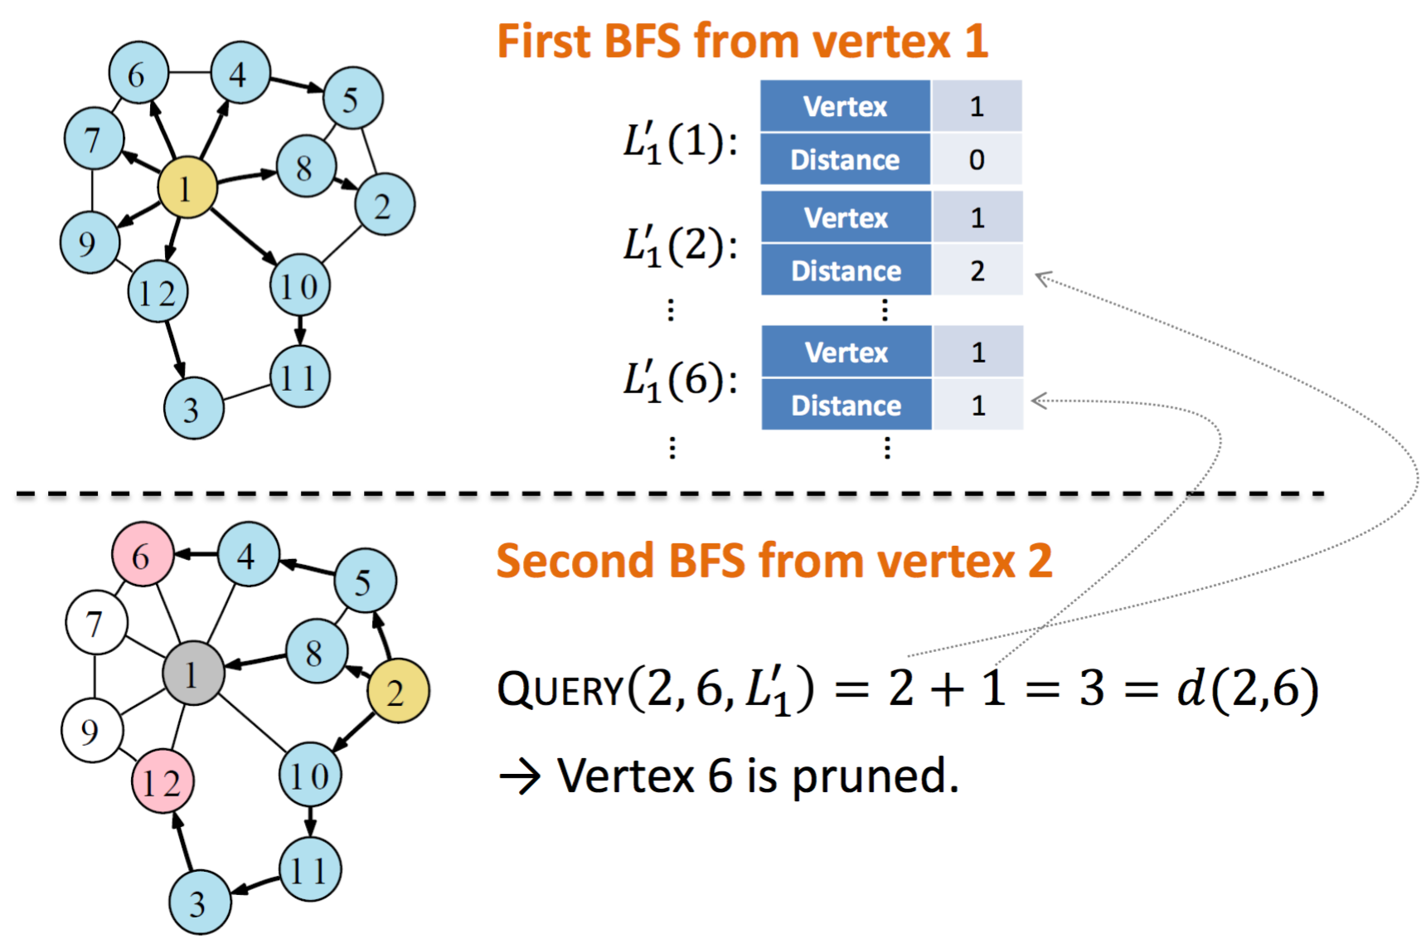
Example

Slide 12
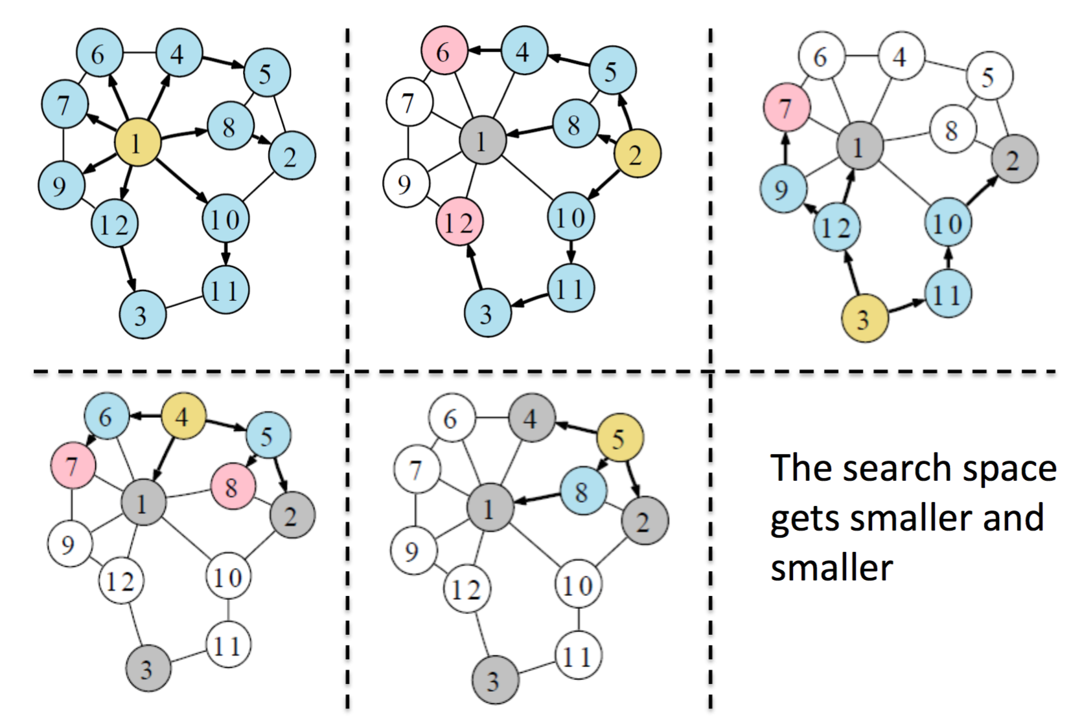
Example

Slide 13
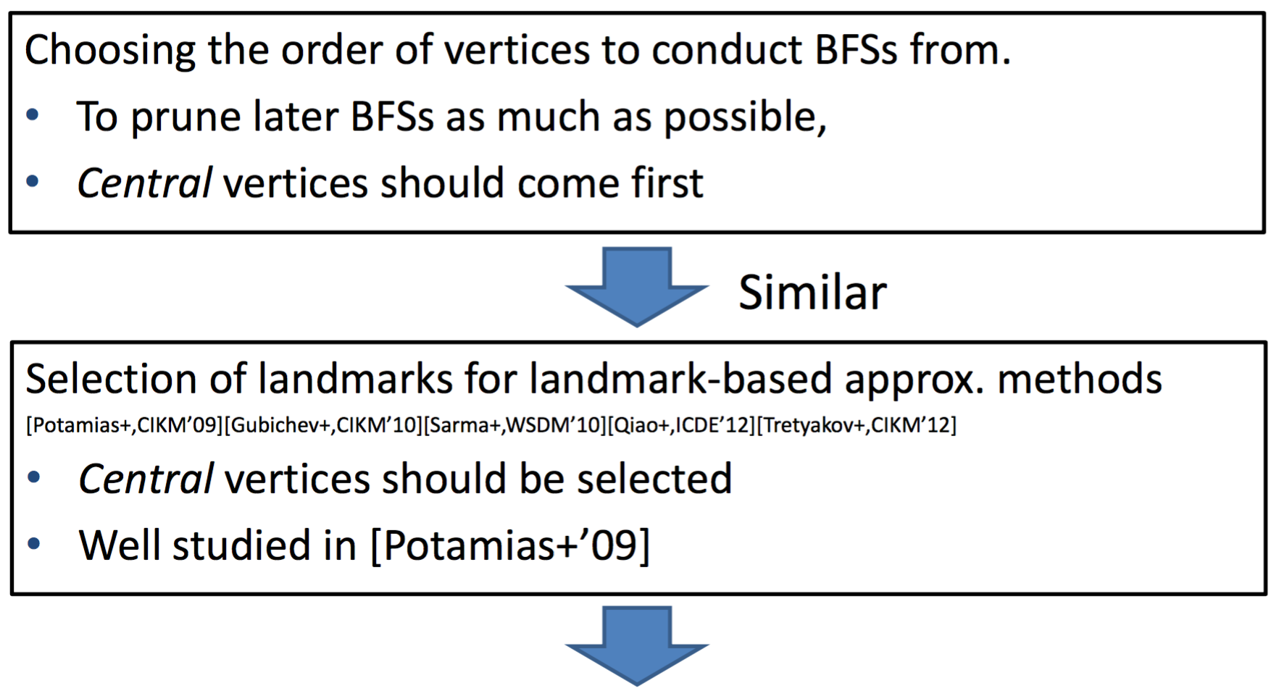
Vertex Ordering Startegies
Conduct BFSs from vertices with higher degree

Slide 14
My ideas
Get more smaller index size and speed up the query time.
1
Path-based package strategy
Choose a more accurate vertex ordering strategy.
2
Approximate Betweenness Centrality

Slide 15
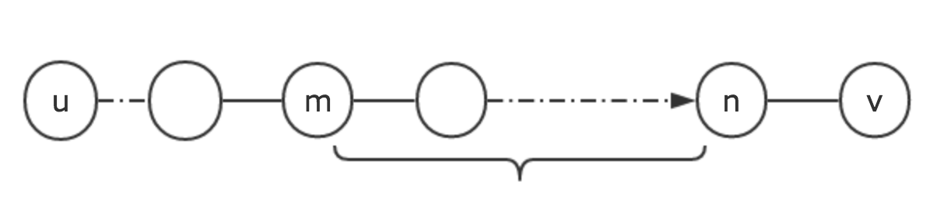
Path-based package strategy
Theorems：
In a shortest path P, the shortest path between each pair of the vertices on the path is the subpath Pi( ) between them.
1 5 6 7 10 11

Slide 16

Path-based package strategy
location of the vertex
on a shortest path
labels between this vertex and
other vertices on the path
one path = many labels
package
do not need to
record some labels
record some paths
reduce the size of the index

Slide 17
Path-based package strategy
How to package?
L label: landmark label
P label: the vertex’s location in path
(vertex,distance)
(-pathNum,location)
Package:
If a L label can be computed from a path we recorded, then it does not need to be record into the index.

Slide 18
Query Algorithm
1、If vertices v, u have same P label，
then d(v, u) = |P(v)-P(u)|
they are on the same path
2、Else,unpack the P labels of v and u:
v and u respectively compute with other vertices that has same P label with them to recover the L labels.
and then, use the original 2-hop algorithm
to compute the shortest distance.

Slide 19
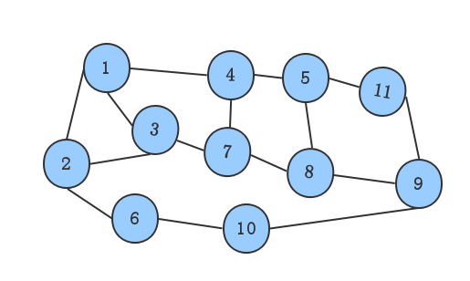
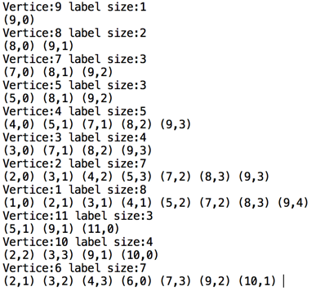

Example
Query d(1,2)
0+1=1
1+1=2
`
`
`
3+4=7
min = 1
Total Labels: 47

Slide 20
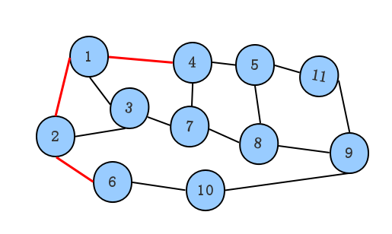
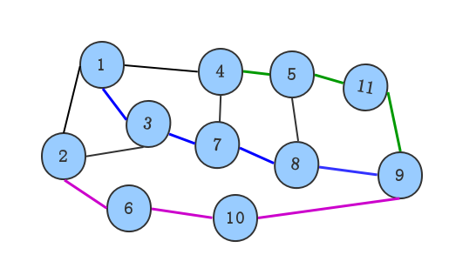
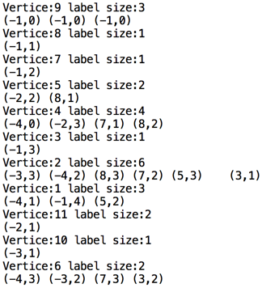


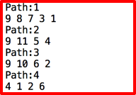
Path-based package strategy
Faster!
d(1,2)= |2-1|=1
Total Labels: 28

Slide 21
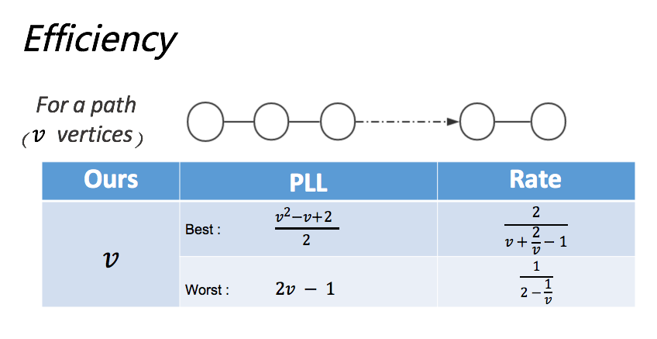
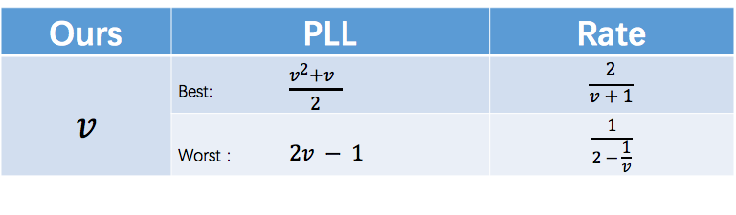
Path-based package strategy

Slide 22
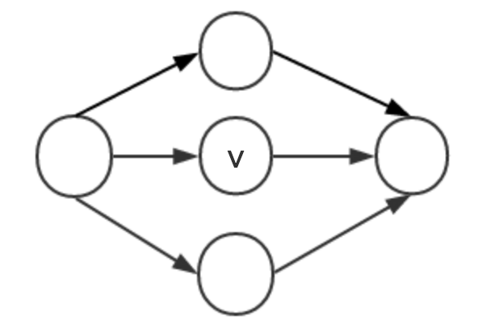
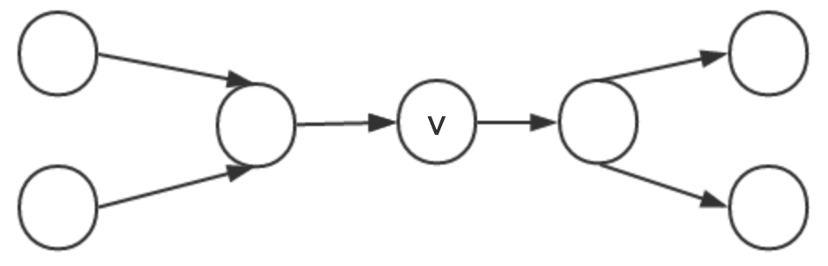
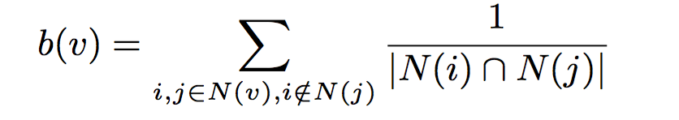
Approximate Betweenness Centrality
Low Betweenness
High Betweenness

Slide 23
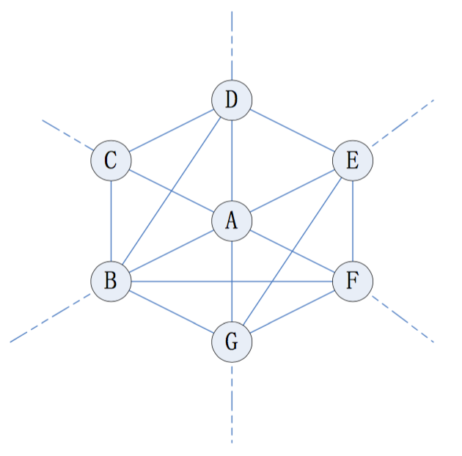
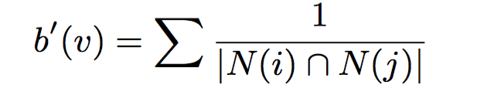
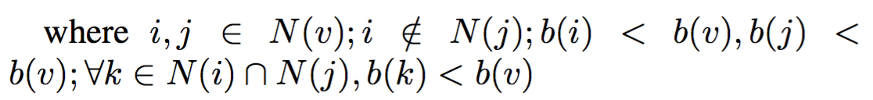
Approximate Betweenness : Adjustment
every rounds when a vertex finishes its Dijkstra, the rest set of uncovered shortest path distance changes, and the betweenness of the rest vertices all changes, a vertex with high centrality may become a low centrality one if most of its neighbors have finished their tasks.

Slide 24
Problems
How to choose the paths to record?
I have tried several methods ,but experiment’s result shows limited improvement.
How to prove the efficiency of the algorithm?
It is hard to predict the algorithm’s efficiency.

Slide 25
Thank You

